Slide 1
Asynchronous Web Apps with Play 2.0
Oscar Renalias

Slide 2
What we’ll do today
Take a look at Play’s asynchronous capabilities
Real world usage scenarios
Notes:
This is what we are going to see today.
We’ll take a look at what are Play’s capabilities and support for asynchronous non-blocking web applications as well as the so-called “reactive IO” paradigm that Play 2.0 brought to us. As we go along, I’ll show some demos that showcase the concepts that we introduced.
This presentation is focused on Play Scala because not all these asynchronous features are fully available in Play Java, and naturally we’ll see some Scala code and some functional code. No need to run away if that’s not your cup of tea or you’re not too good at it ☺, I’ll try to introduce those concepts as best.
This presentation will also try to be as pragmatic as possible because FP is very interesting and has obvious advantages, at the end of the day we have to please and serve our customers and our users and not the FP gods.

Slide 3





About me
Oscar Renalias
oscarrenalias
github.com/oscarrenalias
oscar.renalias@accenture.com
oscar@renalias.net

Slide 4
#wjaxplayasync

Slide 5

?
Stateless
Asynchronous
Reactive
RESTful
Notes:
The Play Framework 2.0 is a fairly new MVC web application framework for a new era of web-based applications that need to deliver at scale.
There’s tons of web application frameworks out there to choose from, but Play stands out because it’s…
…Stateless - by design, Play suggests a stateless nature for your applications. The key example is that Play does not support any kind of database-backed session storage but instead it only offers support for cookie-based sessions, which means that we can only store up to 4kb of serialized data in that cookie. When true shared sessions are needed, Play provides support out of the box for Ehcache, which is a distributed key-value in-memory store. The caching API is pluggable so we can use things like memcache if we prefer. Of course your applications may of course ignore that but Play is built to be and make use of its statelessness.
Asynchronous & Reactive – Play support fully asynchronous operations in two ways: asynchronous response handling so long operations are executed in a separate thread that does not block HTTP threads, and the response is delivered to clients when it’s ready, and non-blocking reactive IO which means that things like handling large file uploads or downloads won’t block a thread for the duration of the process (amongst other use cases). We will concentrate on these capabilities today.
RESTful – Out of the box, all your actions will be RESTful so implementing support for RESTful applications and RESTful APIs is a breeze in Play.

Slide 6

Scalability
Why Async??
Performance
Responsiveness
Notes:
Why do we want to do this?
Scalability – when something is blocked waiting for IO or for an operation that will take long, we’re restricting the scalability of our application since an entire thread is dedicated to wait for whatever is blocking. Once we’ve consumed our thread pool and they’re all waiting for something to happen, no more requests can’t be served and our clients start to pile up. Not good.
Performance – If threads don’t’ get blocked waiting for long-running operations to finish then the throughput of our application will be severly limited; if we can spin off those operations or long running IO to do their own thing separately, we’ve got a chance to serve more clients.
Responsiveness – Now that web applications are more and move moving most of the user interface logic to the frontend with HTML5 and Javascript and the server itself becomes more of a collection of RESTful endpoints that deliver JSON or XML, rendering a single pay may mean a handful of requests to RESTful actions, which should be executed in a non-blocking fashion to prevent any of them for holding others back. Play’s asynchronous architecture can deliver that.
And because users expect all web applications to behave like Facebook, Gmail and Twitter – highly dynamic, user-friendly and responsive. Why should our applications be any different?

Slide 7
Traditional Request Processing Model
Thread pool
Requests
Notes:
This is a simplfiied version of the traditional model, with one thread from the pool per request

Slide 8
Play’s Model
Thread pool
Blocking IO
Asynchronous response
Requests
Notes:
Compared to the traditional threading model for web applications, Play’s is much more flexible because long running operations or blocking IO are not run using threads from the main pool and blocking them in the process. Instead, those threads are now free to serve other incoming requests and another thread will return the response to the client once those operations are completed. It’s much more scalable, provides applications with higher performance and much more responsive.

Slide 9
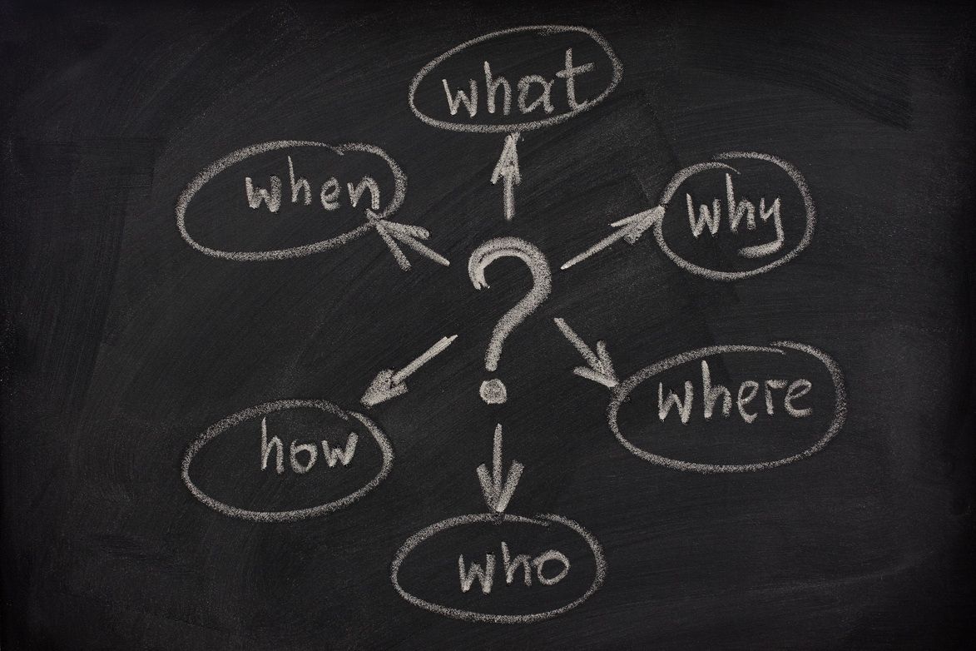
Haven’t we done this before?
Notes:
But – haven’t we tried to do this before, with somewhat mixed results?
YES, we have

Slide 10
Other attempts
App-server specific, e.g. Jetty continuations
NIO/Netty
Servlet 3.0
Vert.x
Node.js
BlueEyes
Notes:
Please note that the asynchronous capabilites are mixed up here: some of these provide asynchronous and non-blocking request handling (Jetty continuations) while others provide non-blocking IO (NIO)
The problem with most of these is that they are either too low-level (NIO and derivatives such as Netty or Servlet 3.0 with explicit async context handling) or are way too verbose and explicit (Jetty continuations)
That does not mean that they are not candidates, depending on the scenario sand requirements. In fact the Play Framework 2.0 itself is built on top of Netty, and its asynchronous abstractions are simply built on top of Netty’s and Akka’s functionalities.

Slide 11
Play’s asynchronous capabilities
Asynchronous requests
Non-blocking reactive IO
Notes:
The Play Framework 2.0 brings both to the table: non-blocking IO using reactive patterns and non-blocking request and response processing.
Let’s take a look at asynchronous request handling first.

Slide 12
Asynchronous Requests
Futures
Promises
Notes:
Futures and Promises are very common abstractions for asynchronous executing of code/functions.

Slide 13
Planning for the Future
A Future is a read-only placeholder for a value that may be available at a later stage
Notes:
A Promise is a result generated by a future, that has not been “extracted” yet.
In Play, Futures and promises are used in very indistinguishable ways most of the times even if they refer to similar concepts.
Optionally, we can block on Futures and Promise while we wait for them to finish.

Slide 14
Futures and Promises
val f:Promise[Something] = Akka.future {
longOperation()
}
val f2:Promise[SomethingElse] = f.map(s=>handleContents(s))
f2.value.fold(
ex=> handleError(ex),
value=> handleOk(value)
)
Notes:
Akka.future is by far the easiest way to generate Promise[Something] in Play.
Technically, we could pretty much handle asynchronous operations like this except that at the end of the processing we would need to block the thread handling our action by requesting the value from the Promise to be unwrapped.
Can we do better?

Slide 15
Asynchronous Results
val promiseOfPIValue: Promise[Double] =
computePIAsynchronously()
val promiseOfResult: Promise[Result] =
promiseOfPIValue.map { pi =>
Ok("PI value computed: " + pi)
}
Promise[Something] → Promise[Result] → Browser
Notes:
The example above is shamelessly ripped from the Play official documentation ☺
Essentially, first we have an operation that generates a Promise of some type, and later we turn that Promise[Something] into a Promise[Result], which is what we can give to Play as an asynchronous result.

Slide 16
Making our actions asynchronous with asynchronous responses
object MyController extends Controller {
def simpleAsyncAction = Action {
val p:Promise[Result] = Akka.future {
val someResult = longOperation()
Ok(someResult)
}
AsyncResult(p)
}
}
Notes:
Replace Ok(“done”) with your own long-running business logic that returns a Result

Slide 17
AsyncResult gets very tedious very soon. Can we do better?
def orders = Action {
Async {
Akka.future {
SalesOrder.findAll
} orTimeout(Ok(Json.toJson(JsonError("Timeout"))), 5, SECONDS) map { orders =>
orders.fold(
orders => Ok(Json.toJson(orders)),
error => Ok(Json.toJson(JsonError("Error")))
)
}
}
}
Notes:
Async is a wrapper for what we’ve seen before and is the preferred way, and it basically takes a Promise[Result] and takes care of waiting for the result to be available, *asynchronously* and return it to the client. In other words, it’s a helper method that builds an AsyncResult from a Promise[Result] automatically for us.
If the content in the red markers is replaced with Json content instead of plain text responses, we’ve got ourselves a JSON API

Slide 18
Asynchronous responses in the real world
def WithFuture[T](seconds:Int)(f: => T)(implicit jsonHelper:Writes[T]) = {
Async {
Akka.future {
f
} orTimeout(Ok(Json.toJson(JsonError(”..."))), seconds, SECONDS) map { result =>
result.fold(
data => Ok(Json.toJson(data)),
error => Ok(Json.toJson(JsonError("Error")))
)
}
}
}
def prettyOrders = Action {
WithFuture(1) {
SalesOrder.findAll
}
}

Slide 19

Demo: Promises, Futures and asynchronous responses

Slide 20
Asynchronous web services
Async {
WS.url("http://.../").get().map { resp =>
Ok(someJsonContent(response))
}
}
Notes:
What if we could do web service calls to other RESTful endpoints asynchronously, and leave the framework the responses whenever they’re ready?
Meet WS.url.
WS.url.get()/post()/etc return a Promise – result: we don’t have to do anything special; let the request finish, do something with its contents, return the promise and let the framework handle the response to the client whenever it’s ready. EPIC WIN.

Slide 21
Demo: Asynchronous web services

Slide 22

IO WHAT??

Slide 23
Reactive IO
“Don’t call us, we’ll call you”

Slide 24
Reactive IO
Enumerator = producer
Iteratee = consumer

Slide 25
Enumerators: the theory
trait Enumerator[E] {
def apply[A](i: Iteratee[E, A]): Promise[Iteratee[E, A]]
}
Enumerator(Iteratee) → Promise[AnotherIteratee]

Slide 26
Enumerators produce data
val stringEnumerator = Enumerator("one", "two", "three", "four")
val updateGenerator = Enumerator.fromCallback { () => Promise.timeout(Some(Update.random), 5000 milliseconds)
}
val e = Enumerator.imperative(...)
e.push(“data”)
e.push(“more data”)
Notes:
From a more pragmatic perspective, enumerators simply produce data. While it is good to know the functional foundations behind Play, we’ll rarely ever have to create our own Enumerators from scratch.
Some of the most common ways to create enumerators are:
Enumerators from a list of strings
Enumerator.fromCallback – return something from a callback, such as Promise.timeout for returning things on a regular schedule, or from really anything that can produce callbacks
Enumerator.imperative is probably one of the easiest enumerators to use since it provides our applications with an imperative approach to push data into it by using its push() method.

Slide 27
Behind the scenes with Iteratees
def fold[B]( done: (A, Input[E]) => Promise[B],
cont: (Input[E] => Iteratee[E,A]) => Promise[B],
error: (String, Input[E]) => Promise[B]
): Promise[B]
Done: there is no more input
Cont: more input incoming
Error: there was an error with the input
Notes:
Essentially, Iteratees act as a sink for input that is generated by an Enumerator and possibly mapped with an Enumeratee.
Working with iteratees consists of repeatedly calling the fold() method with the given input in order to check what the next status is.
But all these operations are fairly low-level, so there are abstractions available that simplify that work in the Iteratee object.

Slide 28
Simplified Iteratees
Iteratee.foreach
Iteratee.fold
Iteratee.consume
Notes:
Iteratee.foreach – provide a function that will process the input given to the iteratee
Iteratee.fold – fold the input with the given function starting with the initial state
Iteratee.consume – Consumes all the input

Slide 29
Enumeratees
Enumerator
Enumeratee
Enumeratee
Iteratee
Notes:
Eumeratees convert the data generated by an Enumerator, and are composable and chainable because an Enumeratee produces a new enumerator.
Some of the common enumeratees as Enumeratee.map, Enumeratee.

Slide 30
Useful Enumeratees
Enumeratee.map
Enumeratee.filter
Enumeratee.drop Enumeratee.take
Notes:
Enumeratee.map processes input data from another enumerator or enumeratee and transforms items with the given function
Enumeratee.filter filters out certain types of input from an enumerator
Enumeratee.drop
Enumerate.take

Slide 31
Composability
val dataGenerator = Enumerator.fromCallback { () =>
Promise.timeout(Some(new java.util.Random().nextInt(100)),
5000 milliseconds)
}
val toStr = Enumeratee.map[Int] { x => x.toString }
val toConsole = Iteratee.foreach[String](println(_))
dataGenerator &> toStr |>> toConsole
Notes:
Enumerators, Iteratees and Enumeratees are composable

Slide 32
Reactive IO and HTTP responses
Ok.feed(iteratee)
Ok.stream(iteratee)
Ok.stream(enumerator)
Notes:
Using Ok.feed and Ok.stream we can use our Iteratees and our Enumerators/Enumeratees to return non-blocking responses to clients. Their non-blocking nature ensures that no processing time is wasted on them while there is no input, while the framework will ensure that data is sent to clients as soon as it becomes available.
Ok.stream will send the response as an HTTP chunked response for us

Slide 33
Reactive IO in the real world
Streaming APIs
File streaming
Server-generated events
Reactive data
WebSockets

Slide 34
Streaming Files
Enumerator.fromFile
Or
Ok.sendFile(new File(…))
Notes:
Enumerator.fromFile gives us a totally straightforward mechanism for streaming data from a file as an Enumerator, which we can naturally map with Enumeratee and process with an Iteratee or just feed it into Ok.stream/Ok.feed.
More generically, Enumerator.fromStream is also available and that will allow us to plug in any InputStream of any kind as an enumerator.

Slide 35
Streaming APIs
Data source (Enumerator) → Enumeratee → Client
Notes:
The easiest way to implement scalable, asynchronous non-blocking streaming APIs is to use Ok.stream as it returns chunked responses and will suspend the thread if no data is available to be pushed.
Our enumerator can be then reading data from a database, waiting for external events (like a PushEnumerator) or reacting to a callback event like Enumerator.fromCallback.
Naturally the data produced by the enumerator can be transformed using Enumeratees along the way.

Slide 36
WebSockets
def websocketTime = WebSocket.async[String] { request =>
Akka.future {
val timeEnumerator = Enumerator.fromCallback { () =>
Promise.timeout(Some((new Date).toString()), 5000 milliseconds)
}
val in = Iteratee.foreach[String] { message =>
println(message)
}
(in, timeEnumerator)
}
}
Notes:
WebSockets in Play are built on top of Enumerators and Iteratees. The main thing to keep in mind with websockets is that we must always return a pair of an iteratee and an enumerator; if using WebSocket.async we’ll wrap them in a future and if using WebSocket.using, we’ll return them unwrapped.
This means that when using websockets we have to be very much explicit about how we expect the websocket to produce and consume the data; here the “produce” step

Slide 37
Demo: Reactive IO
Notes:
Now we’re going to see a brief demo of all the concepts we’ve seen so far:
An HTTP publish-subscribe type of API built using an imperative enumerator and an Actor to process events and distribute them to clients. Since one enumerator can only feed one iteratee (it’s a 1:1 relationship as opposed to 1:n), we need this actor to react to a message event and push it into all the PushEnumerators that it will keep in an internal list. Not a single blocking code in sight.
A model class that returns an Enumerator rather than a list of elements. The biggest advantage here is that for large amounts of data, we are not loading all of them into memory and then returning it to the calling class but instead data is delivered to the client as it is loaded from the database.
WebSockets - TODO

Slide 38
A glimpse of the future: Reactive Mongo
val cursor = collection.find(query)
val futureListOfArticles: Future[List[Article]] = cursor.toList
futureListOfArticles.onSuccess { articles =>
for(article <- articles)
println("found article: " + article)
}
Notes:
http://reactivemongo.org/
ReactiveMongo is a library currently under development that formalizes the usage of Play’s reactive IO for accessing a MongoDb data storage using the non-blocking patterns that we have just seen such as enumerators and Futures.

Slide 39
All work and no makes Jack a dull boy (but there’s still hope)
Grails 2.0 + Servlet 3.0
def index() {
def ctx = startAsync()
ctx.start {
new Book(title:"The Stand").save()
render template:"books", model:[books:Book.list()]
ctx.complete()
}
}
Notes:
Can’t work with Play? No problem, other frameworks are catching up and eventually the development of asynchronous applications will be commonplace.
One of the biggest enablers of asynchronous applications is the servlet 3.0 spec, which allows applications to mark certain requests as suspended and allow the app server to handle those in the background.
The example above is based on Grails 2.0 + a Servlet 3.0 server (such as Tomcat 7.0), just to see how it works. As you may have already noticed, it shows a bit too much of the low-level interface by forcing controller classes to handle asynchronous contexts… In my opinion Play’s API is more elegant but Groovy lends itself very nicely to internal DSLs so it’s likely that the Grails guys will work on some higher-level abstractions to make development easier.
Note: the example is taken from the Grails 2.0 release notes.

Slide 40
All work and no makes Jack a dull boy (but there’s still hope)
Vert.x
public class ServerExample extends Verticle {
public void start() {
vertx.createHttpServer().requestHandler(new Handler<HttpServerRequest>() {
public void handle(HttpServerRequest req) {
System.out.println("Got request: " + req.uri);
System.out.println("Headers are: ");
for (String key : req.headers().keySet()) {
System.out.println(key + ":" + req.headers().get(key));
}
req.response.headers().put("Content-Type", "text/html; charset=UTF-8");
req.response.end("<html><body><h1>Hello from vert.x!</h1></body></html>");
}
}).listen(8080);
}
}
Notes:
Vert.x defines itself as “Effortless asynchronous application development for the modern web and enterprise”. It’s not a coincidence that in their efforts to implement a high-performance asynchronous web framework, the Vert.x development team also kept away from JEE ☺
However as opposed to Play, Vert.x’s architecture is based on the callback-style mechanism. While I have no direct experience developing large-scale applications or applications with complex logic on Vert.x, it remains to be seen how efficient this approach is in those cases.

Slide 41
Github repo or it didn’t happen
https://github.com/oscarrenalias/wjax-2012-play-async-apps
Notes:
The link above contains all the example code showed today as well as other stuff that we did not have time to cover.

Slide 42
Notes:
Shameless plug ☺
At Accenture we have also been training ourselves with Play 2.0 (both Java and Scala) and we are currently delivering an interesting project on Play Java and preparing to deliver an even more interesting one with Play Scala to implement a highly-scalable API so we are ready to help you and clients in general with these innovative technologies and frameworks (even if innovation and say, Scala, are not the first things that come to your minds when you think of Accenture)

Slide 43
?

Slide 44
Thank you

